Slide 1
Entrepreneurship Development
Nilesh Chanewar

Slide 2
Entrepreneurship Development
Introduction: Discover yourself-Find you Flow, Effectuation,Identify your Entrepreneurial Style

Slide 3
Definitions
Entrepreneurship is the process of designing, launching and running a new business offering a product, process or service for sale or hire.
The people who create these businesses are called Entrepreneurs.
The project or undertaking that is especially difficult, complicated or risky is known as Enterprises.
(The person/ The Actor) ( The process/The Act) ( The outcome)
Entrepreneur
Entrepreneurship
Enterprise

Slide 4
What is Entrepreneurship?
Entrepreneurship is the process of setting up one’s own business as distinct from pursuing any other economic activity, be it employment or practicing some profession. The person who set-up his business is called an entrepreneur.
Entrepreneurs not only search for new market demand, but also create demand by studying the market
Example:
Just opening a new restaurant is neither innovative nor entrepreneurial
McDonald’s – while it did not invent anything, it is an entrepreneurship
By applying mgmt concepts and mgmt techniques
standardizing the “product”
designing process and tools
by training on the analysis of the work to be done and then setting the standards it required
McDonald’s both drastically upgraded the yield from resources, and created a new market and a new customer

Slide 5
ENTREPRENEUR is a person who:
rather than becoming a part of the problem, proactively tries to solve it
uses personal creativity and intellect to develop innovative solutions
thinks beyond resources presently controlled in exploiting the emerging opportunities or attending to the impending problems
has the conviction to convince others of one’s ideas and seek their commitment towards the project
has the courage of heart to withstand adversities, persist despite setbacks and be generally optimistic

Slide 6
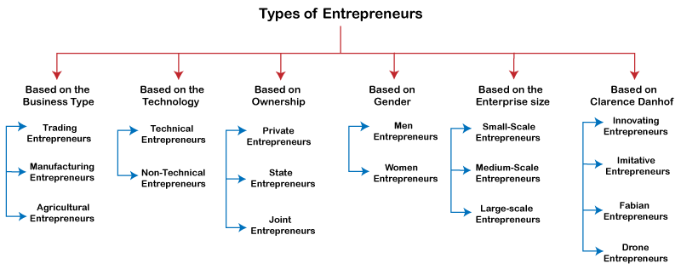
Entrepreneurship Development

Slide 7
Types of Entrepreneurship
Small business entrepreneurship
Large company entrepreneurship
Scalable start-up entrepreneurship
International entrepreneurship
Social entrepreneurship
Environmental entrepreneurship
Technopreneurship
Hustler entrepreneurship
Innovative entrepreneurship
Imitative entrepreneurship
Researcher entrepreneurship
Cyberpreneurship

Slide 8
Varieties of Entrepreneurships
Agricultural/Rural Entrepreneurship
FarmsNFarmers.org – soil & climate conditions to farmers
Barrix.in – pheromone based pest control
Industrial entrepreneurship
Technopreneurship
E-bay, Amazon, Google
Netpreneurship
E-learning platforms
Netflix
Green/Environmental or Ecopreneurship
Waste Ventures – nutrient-rich organic compost from waste
Fourth Partner Energy – rooftop solar projects
Intra-corporate/firm or Intrapreneurship
Social entrepreneurship
Charity: water – clean drinking water around the world
Better World Books – reuse or recycle books to promote literacy

Slide 9
Characteristics Of Entrepreneurship
1. Systematic Activity | systematic, step-by-step and purposeful temperamental, skill and other knowledge and competency requirements can be acquired, learnt and developed
2. Lawful and Social | Purpose of entrepreneurship is creation of value for personal profit and social gain legally
3. Innovation | creation of value introduction of new products discovery of new markets and sources of supply of inputs technological breakthroughs newer forms for doing things better, cheaper, faster
4. Organiser / Leader | knowledge about availability and location of the resources the optimum way to combine them product development and development of the market for the product

Slide 10
Characteristics of entrepreneurship
Here are a few characteristics of entrepreneurship:
Creativity and innovation: Entrepreneurship is about coming up with new and creative ideas and implementing them to achieve substantial profits. For example, service innovation could be coming up with technologies to reduce cost and increase productivity.
Risk-taking ability: The willingness to bear risk is the essential characteristic of entrepreneurship. Risk occurs when you implement a new idea and it fails. Entrepreneurs take calculated risks because they enjoy the challenges that come up with implementing a new idea.
Profit-making: Except for social entrepreneurship, all other types of entrepreneurship work with the sole aim of making a profit. It is the reward that entrepreneurs get for taking a risk with a new idea.
Economic activity: Entrepreneurship involves creating, managing and running an organization. Moreover, it generates employment and ensures optimum utilization of resources to earn the maximum profit.

Slide 11
Characteristics of Entrepreneur
be passionate about achieving their goal
have a spirit of adventure
have a strong need to achieve and seek personal accomplishment
be passionate about achieving their goals
be self-confident and self-reliant
be goal-oriented
be innovative, creative, and versatile
be persistent
be hardworking and energetic
have a positive attitude
be willing to take initiative
have a strong sense of commitment

Slide 12
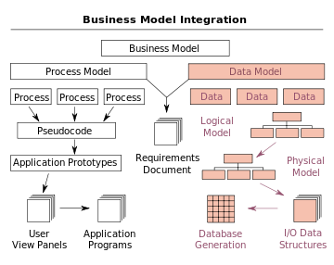

Slide 13
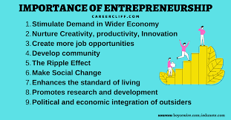

Slide 14
Entrepreneurship Development
What Is a Flow State of Mind?
4 Examples of Flow in Action
Flow Activities: How to Get Into a Flow State

Slide 15
Entrepreneurship Development
A flow state of mind spontaneously arises when we become immersed in an activity so completely that we lose track of time.
1. Music
2. Gaming
3. Learning
4. Hobbies

Slide 16
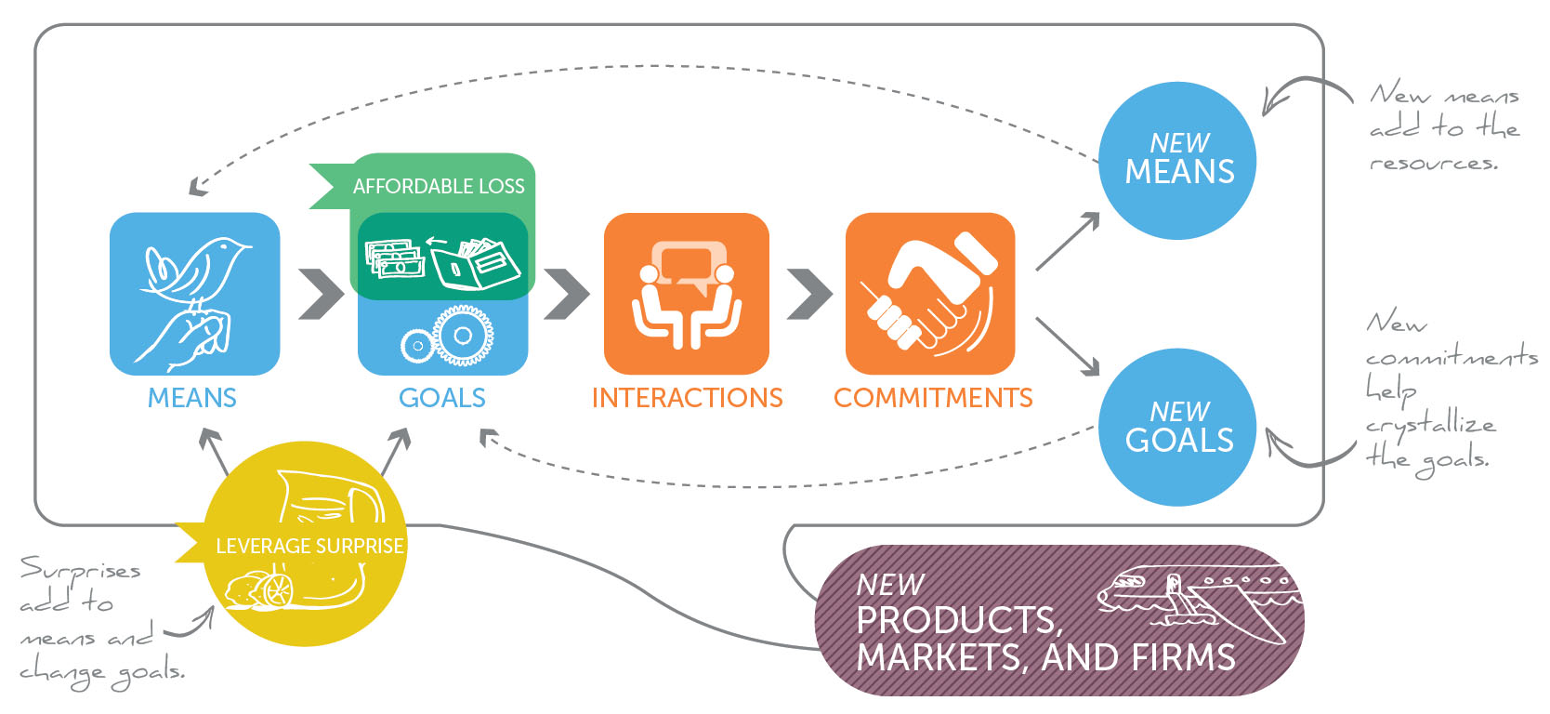
Effectuation

Slide 17
The Principles of Effectuation
Effectuation is a way of thinking and decision-making that is based on the idea that entrepreneurs create their future by taking action and making things happen.
Bird In Hand Principle
Affordable Loss Principle
Crazy Quilt Principle
Lemonade Principle
Pilot in the Plane Principle
Effectual Cycle

Slide 18
Bird In Hand Principle
When expert entrepreneurs seek to build a new venture, they start with their means. These means can be grouped into three categories:
Who I am—my traits, tastes, and abilities
What I know—my education, training, expertise, and experience
Who I know—my social and professional networks.
Using a combination of these means, the entrepreneur begins to imagine possibilities and take action.

Slide 19
Affordable Loss Principle
In much of the business world, the manager in charge of launching a new product analyses the market and chooses segments with the highest expected value. It is a natural reflex that is the result of years of training around a single mantra: maximize returns by selecting the optimal strategy for your target. Expert entrepreneurs turn this logic on its head—they think in terms of affordable loss rather than expected returns.

Slide 20
Crazy Quilt Principle
The crazy quilt principle of effectual reasoning is the focus on building partnerships rather than beating competitors. Since entrepreneurs tend to start the process without assuming the existence of a predetermined market for their idea, they don’t know who their competitors will be, so detailed competitive analyses have little value. Instead, entrepreneurs generally take the product to the nearest potential customer.

Slide 21
Lemonade Principle
If you come across lemons, make lemonade! The third principle of effectual reasoning is at the heart of entrepreneurial expertise—the ability to turn the unexpected into the profitable. Expert entrepreneurs learn not only to work with surprises but also to take advantage of them.

Slide 22
Pilot in the Plane Principle
The struggle for personal control is as old as humankind itself—primitive and innate. There is abundant evidence that most people desire control of the events in their lives, indeed over their lives, and that such strivings for control span history and cultures.
Focus on today, not next year.

Slide 23
Effectual Cycle
The entrepreneur’s means provide the starting point. The action begins in earnest when the entrepreneur begins interacting with people. Sometimes the starting point of that interaction is an idea, a provisional goal the entrepreneur uses to initiate the interaction and complete the cycle.

Slide 24
Entrepreneurial style
CREATOR “Create a better product” Bill Gates, Steve Jobs, Richard
SUPPORTER “Leading the Team” Jack Welch, Meg Whitman
DEAL MAKER “Bringing People Together” Donald Trump, Rupert Murdoch
TRADER “Buying Low, Selling High” George Soros, John Templeton
ACCUMULATOR “Collecting Appreciating Assets” Warren Buffet
LORD “Controlling Cash Generating Assets” Andrew Carnegie
MECHANIC “Creating a Better System” Henry Ford, Ingvar Kamprad (IKEA),

Slide 25
Business Activities

Slide 26
Stages Business Making
Identify Problems Worth Solving
BUSINESS MODEL
Identify Your Customer
Segments and Early Adopters
Discover Yourself
CUSTOMER
Get Started with Lean Canvas
Craft Your Value Proposition
IDEA/PROBLEM

Slide 27
Design Thinking
Principles:
Design thinking is an iterative approach that enables design and development teams to focus on issues and take action to overcome them. Through the design thinking method, teams can build problem-solving products by working on prototypes after understanding what customers really want.

Slide 28
4-phase version
In the online course ”Design Thinking and Innovation”, Harvard Business School Dean Srikant Datar leverages a four-phase innovation framework. The phases venture from concrete to abstract thinking and back again as the process loops, reverses, and repeats. This is an important balance because abstract thinking increases the likelihood that an idea will be novel. It’s essential, however, to anchor abstract ideas in concrete thinking to ensure the solution is valid and useful.
Here are the four phases for effective innovation and, by extension, design thinking.

Slide 29
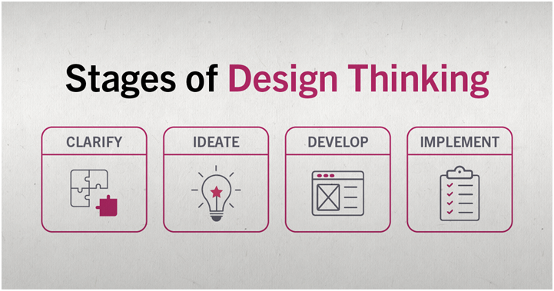
4-phase version

Slide 30
Rules of Design Thinking
Christoph Meinel and Harry Leifer of the Hasso-Plattner-Institute of Design at Stanford University (d.school) identified four rules of Design Thinking:
The human rule: design is social in nature — problems must be solved in a way that satisfies human needs and acknowledge the human elements in all technologies.
The ambiguity rule: ambiguity is inevitable — experiment at the limits of our knowledge, the limits of our ability to control events, and with the freedom to see things in a different light.
The re-design rule: all design is re-design — technology and social circumstances are constantly evolving. We need to understand how our human needs were met in the past.
The tangibility rule: making ideas tangible facilitates communication — this directly refers to creating prototypes.

Slide 31
5-phase version
The 5 step process proposed by the Hasso-Plattner Institute of Design at Stanford is as follows:
1. Empathize
The empathize stage is critical to understand where the problems you are trying to solve come from. Immerse yourself into the life of your user to understand their problems. This can also be thought of as finding “gaps in the market”, where there are no straightforward product solutions to a given issue. Identify the need and address it. This phase focuses on research.
2. Define
Now that a need is identified and research is collected, you can define the problem in human-centric terms. You want this problem to be broad enough for a flexible and creative approach, but narrow enough to hone in on the problems niche.
An example of a successful human-centric problem definition could be:
“Professionals need a way to virtually take notes, mark their calendar, set reminders, and sync them for access on work and home devices to streamline organization.”

Slide 32
5-phase version
3. Ideate
Now that you understand your users problems and have analyzed your research, you can begin generating ideas to solve the defined problem.
A popular way to generate ideas is with a brainstorm. Arrange a meeting with at least four people to start off. Try to come up with as many phrases or word associations as you can — no limits, no rules! Bring in a couple individuals from other teams. People with outside experience contribute valuable ideas by looking at the problem through an alternative lens. The ideate phase focuses on free thinking and unconventional approaches.
4. Prototype
Using the best ideas from the ideate phase, you can now produce several basic iterations of your problem solving product. Early stages of the prototype phase are generally where user testing allows designers to identify kinks or missing elements of their designs. This stage focuses on experimenting by creating multiple approaches to solving the problem.

Slide 33
5-phase version
5. Test
The final stage of the design thinking process, designers now combine the best solutions from the prototype phase into one complete product. This phase involves the most user-testing.
However, the design thinking phases are not linear and the test phase is not a strict ending point. Often, testing the final product surfaces new problems and is followed by another define phase, or redirects designers to the empathy phase to work on building a deeper understanding of the user. Even if designers do not need to back track to different phases, the test phase focuses on fine-tuning the product to create the best possible solution.

Slide 34
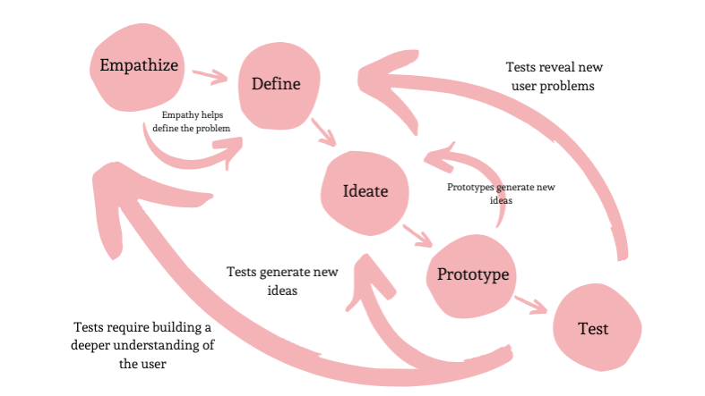
Summary

Slide 35

GOOTB

Slide 36
GOOTB
Pronounced “go͞ot-bə,” it stands for Getting Out Of The Building.
The phrase comes from the practice of intentionally going out into the world for research as opposed to just getting information from people around you at home, from friends, in the office, or at school.
It could just as easily —and perhaps more accurately— be GOOYB: Getting Out Of Your Bubble.
Product teams make strides to involve customers early on at the discovery stage and then after a period of building their solutions, validate their prototypes/products with customers. The fault in this is the huge gap between the discovery stage and launch stage where teams don’t engage customers and possibly build something completely disparate from what the market needs, hence leading to huge UX debt.

Slide 37
GOOTB
According to Steve Blank in his acclaimed book, ”The Four Steps to the Epiphany”, the ideal approach is to embrace a culture of cultivating a frequent customer feedback loop throughout the product development cycle with the mindset that a bulk of the answers are out there — not in our designer minds, sticky notes or computers and will only remain latent until we engage customers.
Customer discovery which entails observing & interviewing customers seeks to discover their behaviors, motivations, and needs, expose problems and design opportunities, and find crucial information to drive design decisions.

Slide 38
Customer discovery which entails observing & interviewing customers seeks to discover their behaviors, motivations, and needs, expose problems and design opportunities, and find crucial information to drive design decisions.
GOOTB (Get out of the building) encourages an outside-in approach, a continuous customer feedback loop throughout the product development cycle. It religiously tilts away from the culture of building products with assumptions or pure logic.

Slide 39
Customer Segmentation Models: Types, Benefits & Uses
No two customers are exactly alike.
your brand can not serve a wide variety of people
take a scattershot approach, throwing everything at the wall and hoping something sticks
you could create a laser-focused strategy - one that tailors your marketing efforts to the needs and interests of specific groups of customers
Understanding your customers is key to the success of your business

Slide 40
What is a Customer Segmentation Model?
A customer segmentation model is a way of dividing a wide group of people into smaller groups based on their commonalities. How you divide your larger customer base into those smaller subgroups will vary based on what your brand does and who your customers generally are.
If you’re a business-to-business brand providing accounting services to small and medium-sized businesses, one of your segmentation models may focus on the different industries in which your customers’ businesses operate.
For a business-to-consumer brand, your customer segmentation models may focus on shared demographics like age, gender, and income level.

Slide 41
What Are the Benefits of a Customer Segmentation Model?
Customer segmentation models allow you to create increasingly specific marketing messages tailored to the right person at the right leg of their customer journey.Why waste time on guesswork when a segmentation strategy based on the right-for-you model lets you target exactly who needs what and when?
Benefits of finding the right customer segmentation model include:
Increase consumer engagement.
Increase consumer satisfaction and loyalty
Improve ROI

Slide 42
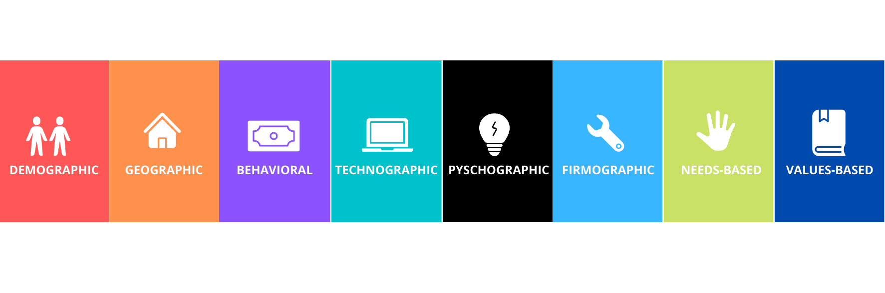
Types of Customer Segmentation Models

Slide 43
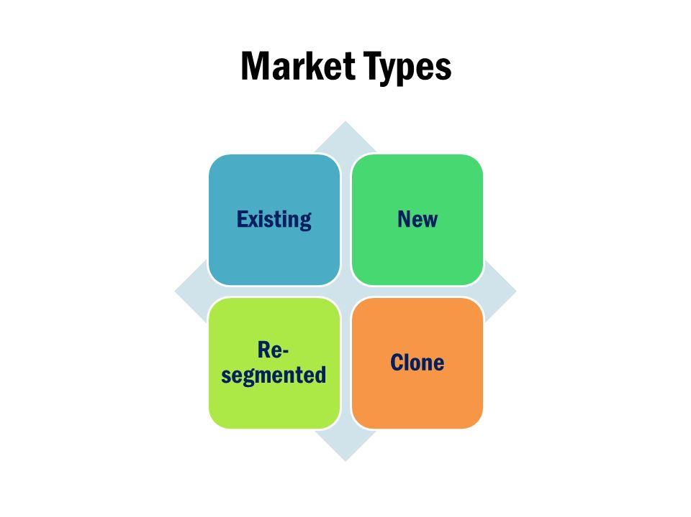
MARKET

Slide 44
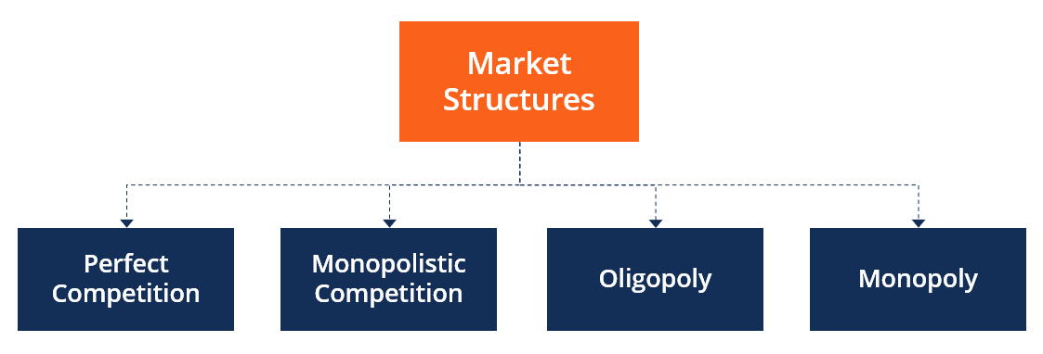

Slide 45
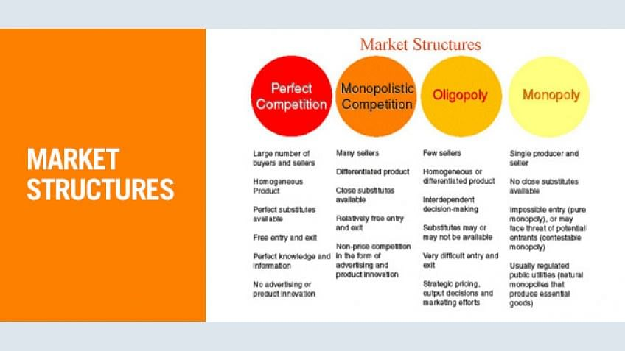
Customer Segmentation Models

Slide 46
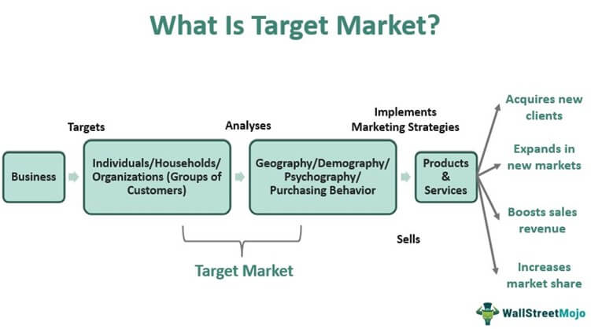

Slide 47
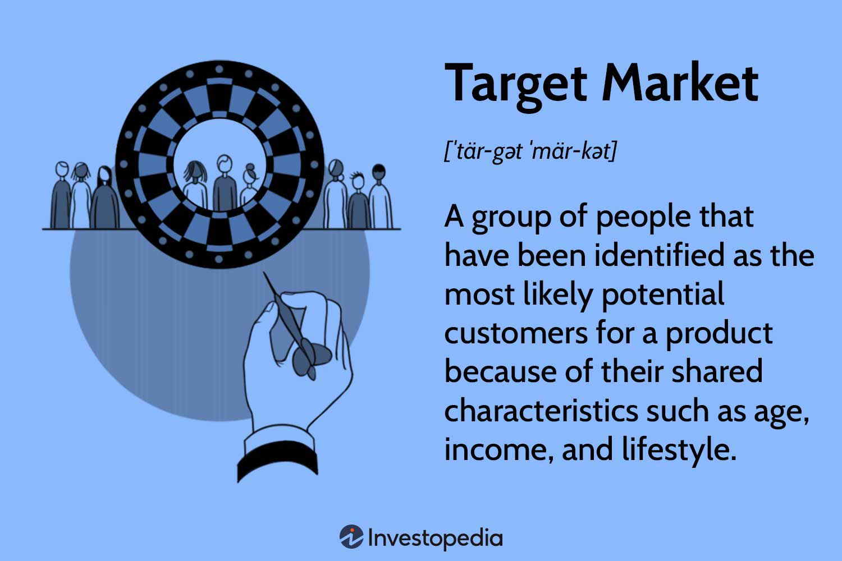

Slide 48
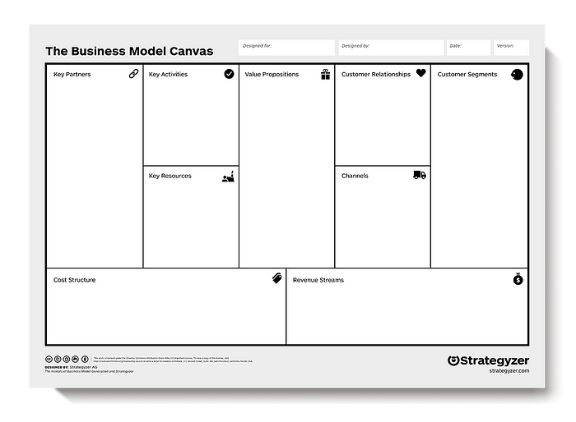

Slide 49
